Slide 1
Hot Wheels automobile spares. Bi dashboard
Kaushik Bandaru
1945699
Assignment 5

Slide 2
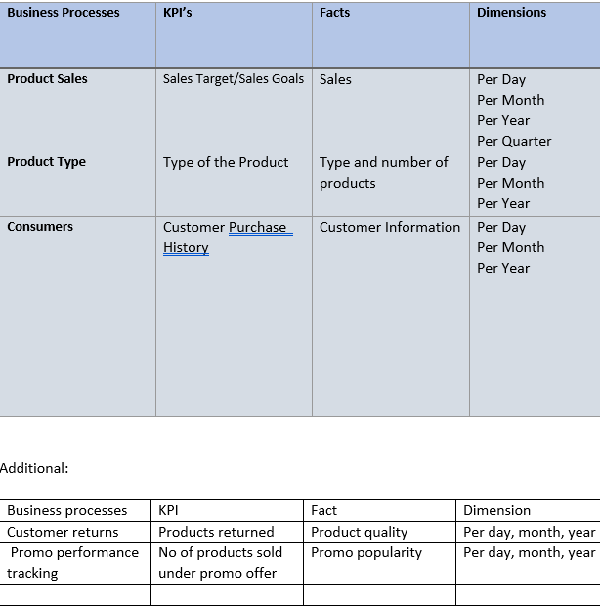
Dimensional table used to build the dashboard

Slide 3
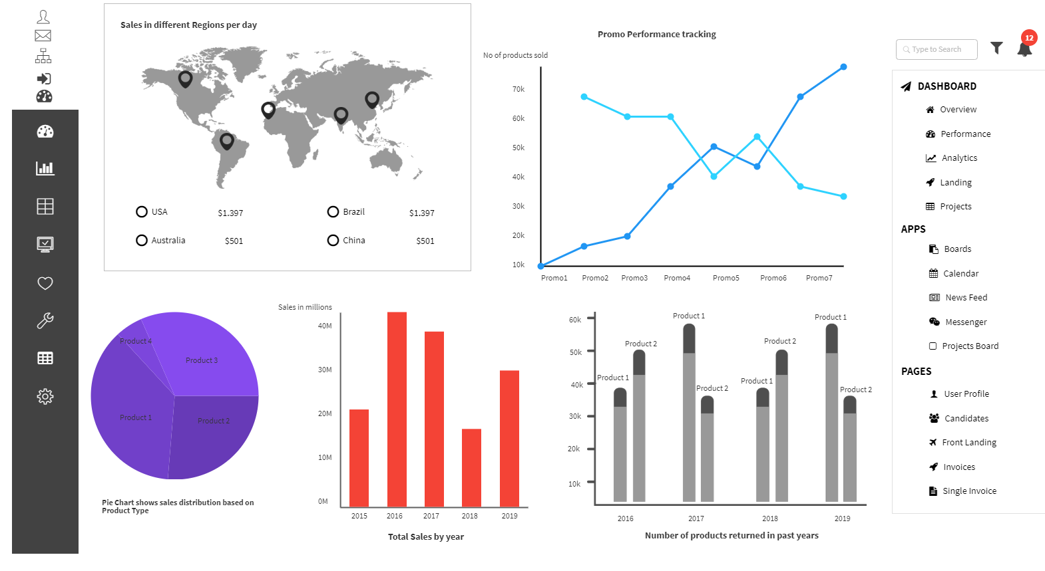
Desktop view of Dashboard
Notes:
This Dashboard has all the KPIs of Hot wheels.
1) Geospatial Map of Sales in different Regions
2) Line Graph showing number of products sold under different promos
3) Pie chart showing sales based on type of product.
4) Histogram showing total Sales in the last 4 years.
5) Bar chart showing number of products returned in last 4 years

Slide 4
Dashboard description
This is a mock dashboard created for the company which represents some graphical visualizations utilizing imperative information of the association to give out valuable data and furthermore helps in better basic leadership. The pie chart helps in understand the sale of every product sold by the company. The line graph shows us the sales happening every month in dollar currency. This can help us understand if the sales is increasing or decreasing in a better way. The Map shows regional sales for the customers. The table shows relationship of the company with other companies. The bar graph represents the promotional sales. This dashboard will be accessible to the higher management of the company i.e. Sales Dept., Inventory Dept., CEO, CTO, CIO, CFO, Finance Dept, etc through company laptops.
This will help the management understand the data better and answer questions like which products are not performing well and in which regions. it also tells us which promos are popular and if sales have gone up or down in last 4 years. This will help the company t build an affective business strategy for future.
The Graphs, Charts and Tables in the dashboard are all the KPI’s for the company which represents the Product Order, Product Types, Product Sales, and Customers.
There are options to search on the dashboard on the right side and to use filter. I have added buttons and tool bar on the left and sidebar on right(to perform analytics) so that the dashboard feels real and not a mock.

Slide 5
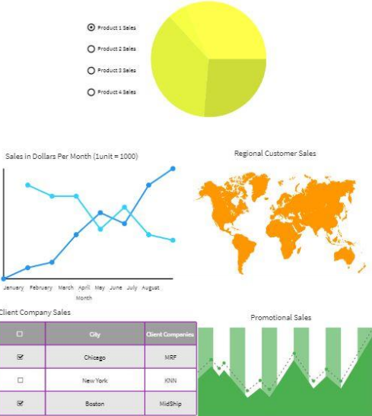
Sales Report
This report shows sales in different perspectives.
Pie chart shows sales based on product type.
Line graph shows sales by month.
Geospatial plot shows sales in different regions.
Area chart shows promo sales .
Tabular column shows sales through client companies.

